Slide 1
Project 1
Stock Market

Slide 2
Problem statement
In such a high volatility from tech companies, our client is looking to invest in different sector. Aerospace & Defense sector
What company should the client invest in?
Metrics
+50 -day volume trading average >=400k
Volatility lower than 20%
ROC higher than S&P500

Slide 3
data
Companies analyzed:
RTX (Raytheon)
GD (General Dynamics)
LMT (Lockheed)
SPY500
All selected companies had outstanding dividend payout last year and they are billion cap companies with high value contracts worldwide.
240 days data
Sources:
https://data.nasdaq.com
https://api.marketstack.com

Slide 4
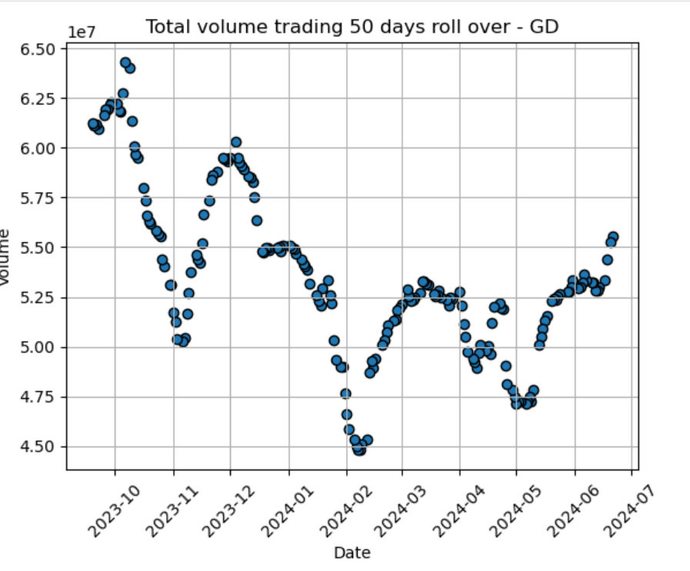
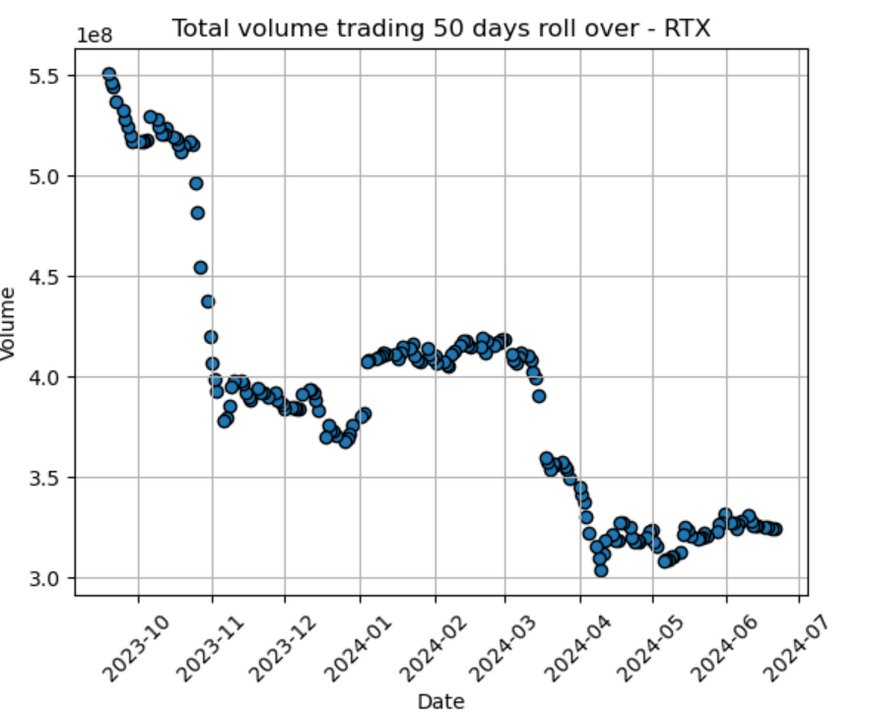
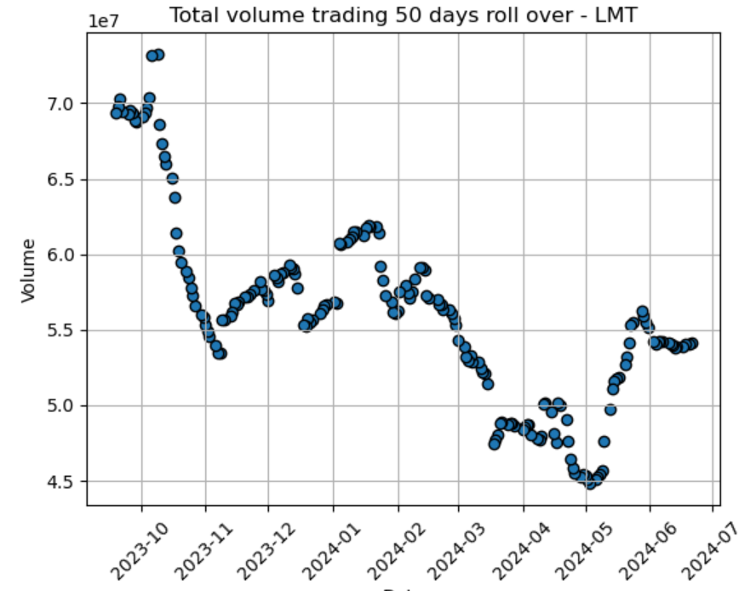
Total Volume trading

Slide 5
Percentage change
Each month from September 2023 to February 2024
Each month from march to august 2024
September 2023: SPY: -3.43%, RTX: -4.01%, LMT: -4.95%, GD: -1.42%
October 2023: SPY: -1.97%, RTX: +13.45%, LMT: +11.17%, GD: +8.94%
November 2023: SPY: +8.87%, RTX: -0.63%, LMT: -1.88%, GD: +2.05%
December 2023: SPY: +4.29%, RTX: +3.26%, LMT: +1.08%, GD: +5.09%
January 2024: SPY: +2.27%, RTX: +8.41%, LMT: -5.48%, GD: +2.05%
February 2024: SPY: +4.84%, RTX: -2.21%, LMT: -0.46%, GD: +2.86%
March 2024: SPY: +2.77%, RTX: +8.70%, LMT: +6.30%, GD: +3.36%
April 2024: SPY: -4.17%, RTX: +4.17%, LMT: +2.38%, GD: -0.22%
May 2024: SPY: +5.18%. RTX: +6.41%. LMT: +1.67%. GD: +4.60%
June 2024: SPY: +2.87%, RTX: -6.39%, LMT: +0.24%, GD: -3.57%
July 2024: SPY: +0.95%, RTX: +16.47%, LMT: +15.11%, GD: +2.53%
August 2024: SPY: +2.01%, RTX: +4.77%, LMT: +4.42%, GD: -0.21%

Slide 6
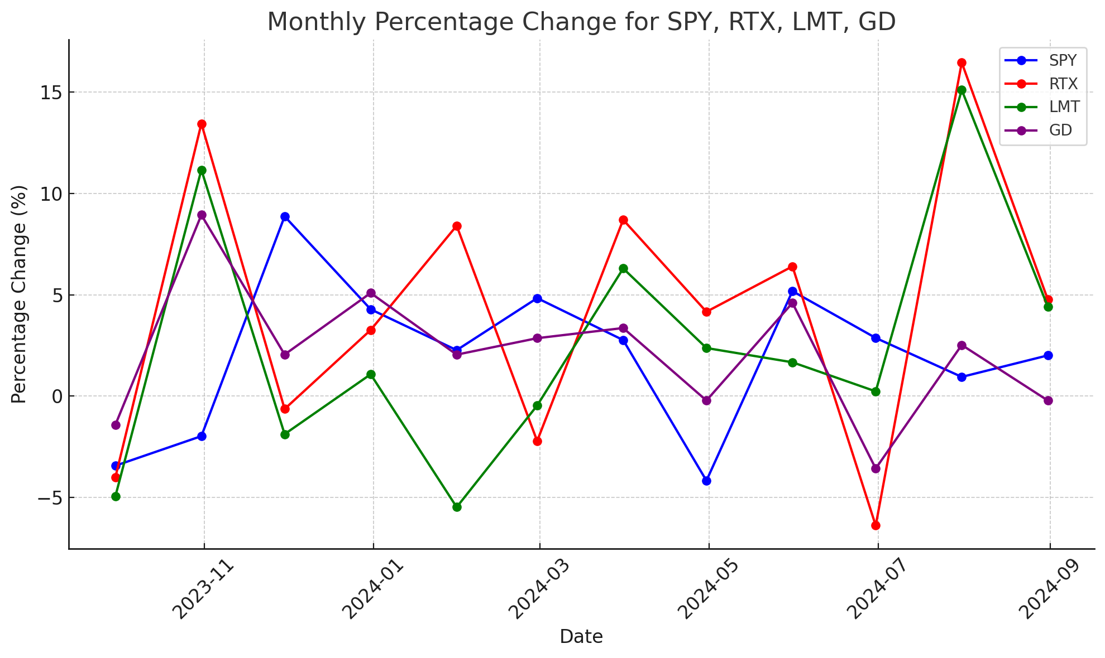
monthly

Slide 7
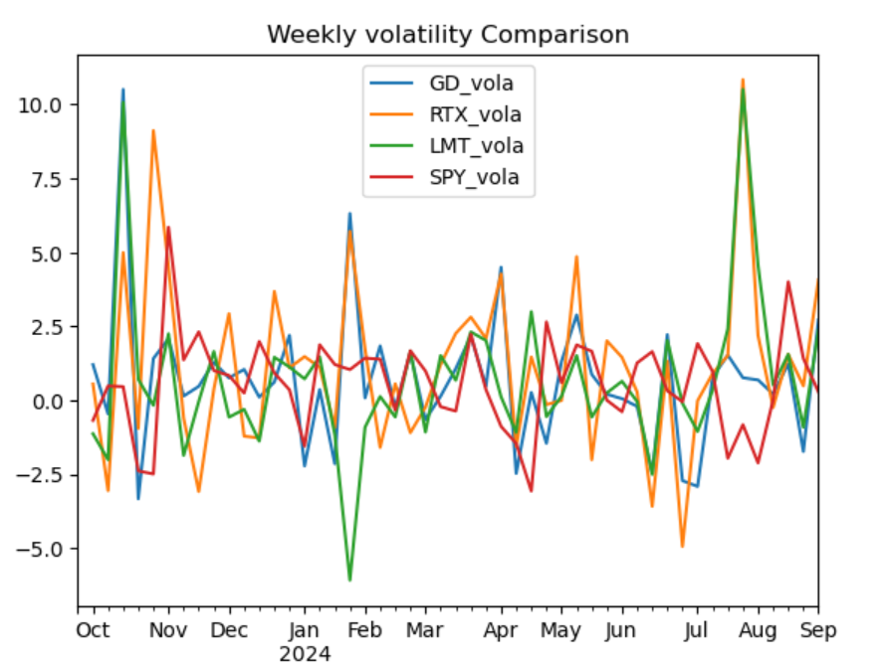
Weekly volatility comparison

Slide 8
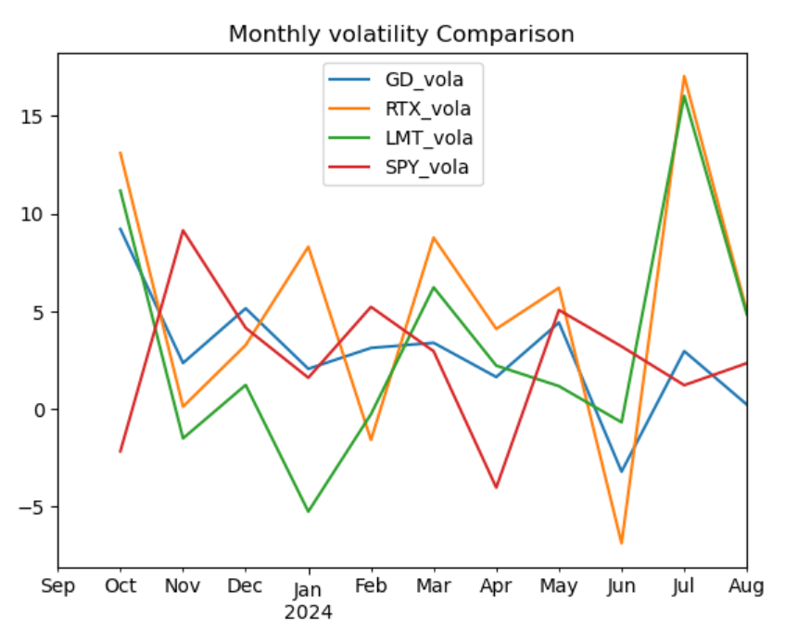
monthly volatility comparison

Slide 9
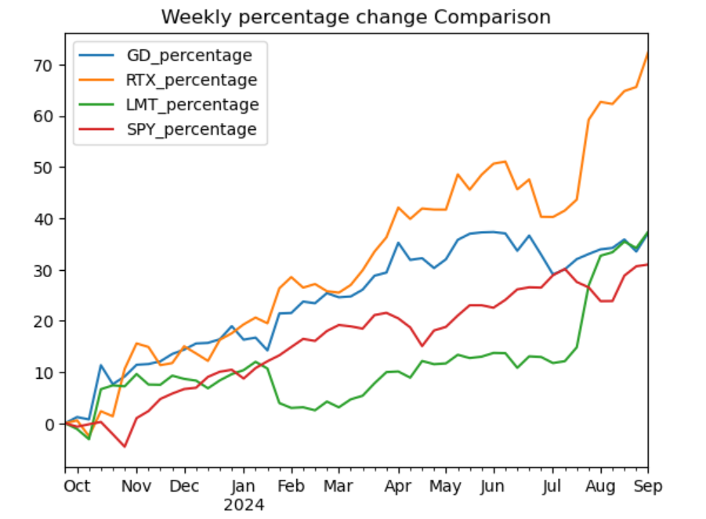
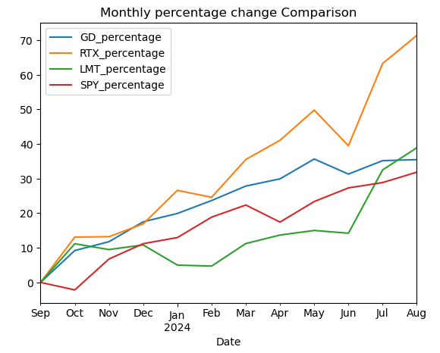
Rate of change (roc)

Slide 10
CONCLUSION
We recommend to invest in RTX(Raytheon),the company has the highest ROC over a year, the stock volume has been trading at 10 times more than direct competitors.
Key Contracts:
Javelin Joint Venture $1.3b
$478m Patriot GETM-T missile
$1.2b to provide additional Patriot air can missile defense to Germany

